Slide 1
Chapter 34
Electromagnetic Waves

Slide 2
Electromagnetic Waves
Mechanical waves require the presence of a medium.
Electromagnetic waves can propagate through empty space.
Maxwell’s equations form the theoretical basis of all electromagnetic waves that propagate through space at the speed of light.
Hertz confirmed Maxwell’s prediction when he generated and detected electromagnetic waves in 1887.
Electromagnetic waves are generated by oscillating electric charges.
  The waves radiated from the oscillating charges can be detected at great distances.
Electromagnetic waves carry energy and momentum.
Electromagnetic waves cover many frequencies.
Introduction

Slide 3
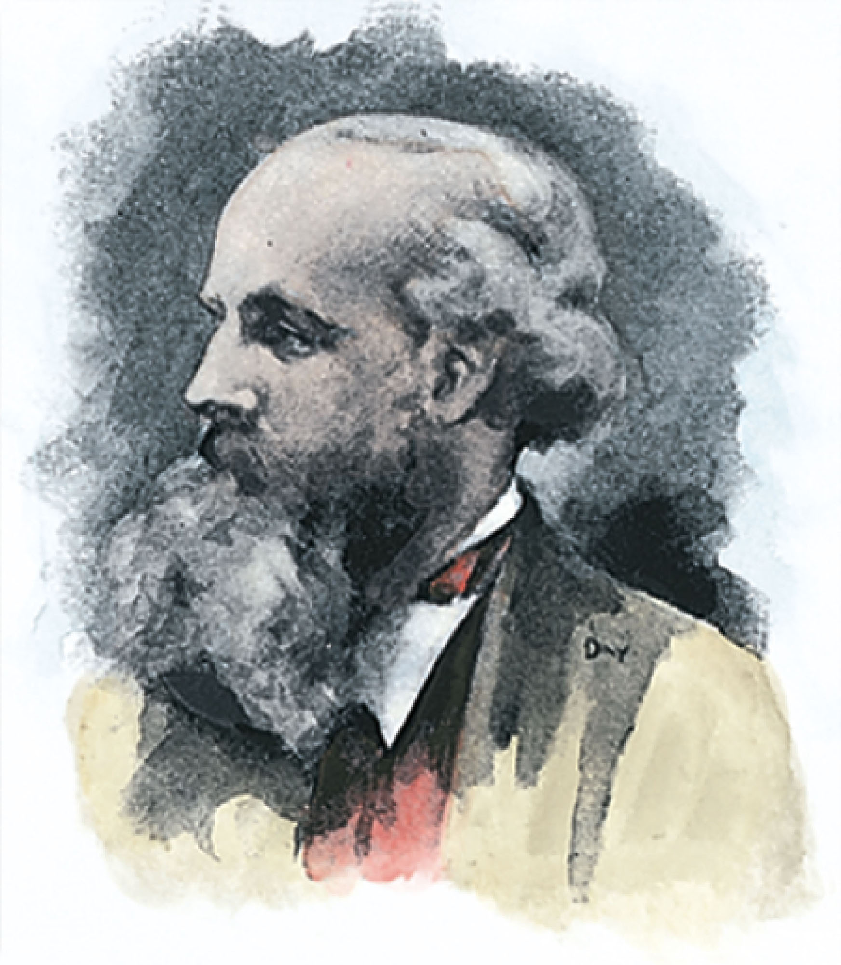
James Clerk Maxwell
1831 – 1879
Scottish theoretical physicist
Developed the electromagnetic theory of light
His successful interpretation of the electromagnetic field resulted in the field equations that bear his name.
Also developed and explained
  Kinetic theory of gases
  Nature of Saturn’s rings
  Color vision
Section 34.1

Slide 4
Modifications to Ampère’s Law
Ampère’s Law is used to analyze magnetic fields created by currents:
But, this form is valid only if any electric fields present are constant in time.
Maxwell modified the equation to include time-varying electric fields.
Maxwell’s modification was to add a term.
Section 34.1

Slide 5
Modifications to Ampère’s Law, cont
The additional term included a factor called the displacement current, I_{d.}
This term was then added to Ampère’s Law.
This showed that magnetic fields are produced both by conduction currents and by time-varying electric fields.
  The general form of Ampère’s Law is
  Sometimes called Ampère-Maxwell Law
Section 34.1

Slide 6
Maxwell’s Equations
In his unified theory of electromagnetism, Maxwell showed that electromagnetic waves are a natural consequence of the fundamental laws expressed in these four equations:
Section 34.2

Slide 7
Maxwell’s Equation 1 – Gauss’ Law
The total electric flux through any closed surface equals the net charge inside that surface divided by ε_{o}
This relates an electric field to the charge distribution that creates it.
Section 34.2

Slide 8
Maxwell’s Equation 2 – Gauss’ Law in Magnetism
The net magnetic flux through a closed surface is zero.
The number of magnetic field lines that enter a closed volume must equal the number that leave that volume.
If this weren’t true, there would be magnetic monopoles found in nature.
  There haven’t been any found
Section 34.2

Slide 9
Maxwell’s Equation 3 – Faraday’s Law of Induction
Describes the creation of an electric field by a time-varying magnetic field.
The emf, which is the line integral of the electric field around any closed path, equals the rate of change of the magnetic flux through any surface bounded by that path.
One consequence is the current induced in a conducting loop placed in a time-varying magnetic field.
Section 34.2

Slide 10
Maxwell’s Equation 4 – Ampère-Maxwell Law
Describes the creation of a magnetic field by a changing electric field and by electric current.
The line integral of the magnetic field around any closed path is the sum of μ_{o} times the net current through that path and ε_{ο}μ_{o} times the rate of change of electric flux through any surface bounded by that path.
Section 34.2

Slide 11
Lorentz Force Law
Once the electric and magnetic fields are known at some point in space, the force acting on a particle of charge q can be found.
Maxwell’s equations with the Lorentz Force Law completely describe all classical electromagnetic interactions.
Section 34.2

Slide 12
Speed of Electromagnetic Waves
In empty space, q = 0 and I = 0
The last two equations can be solved to show that the speed at which electromagnetic waves travel is the speed of light.
This result led Maxwell to predict that light waves were a form of electromagnetic radiation.
Section 34.2

Slide 13
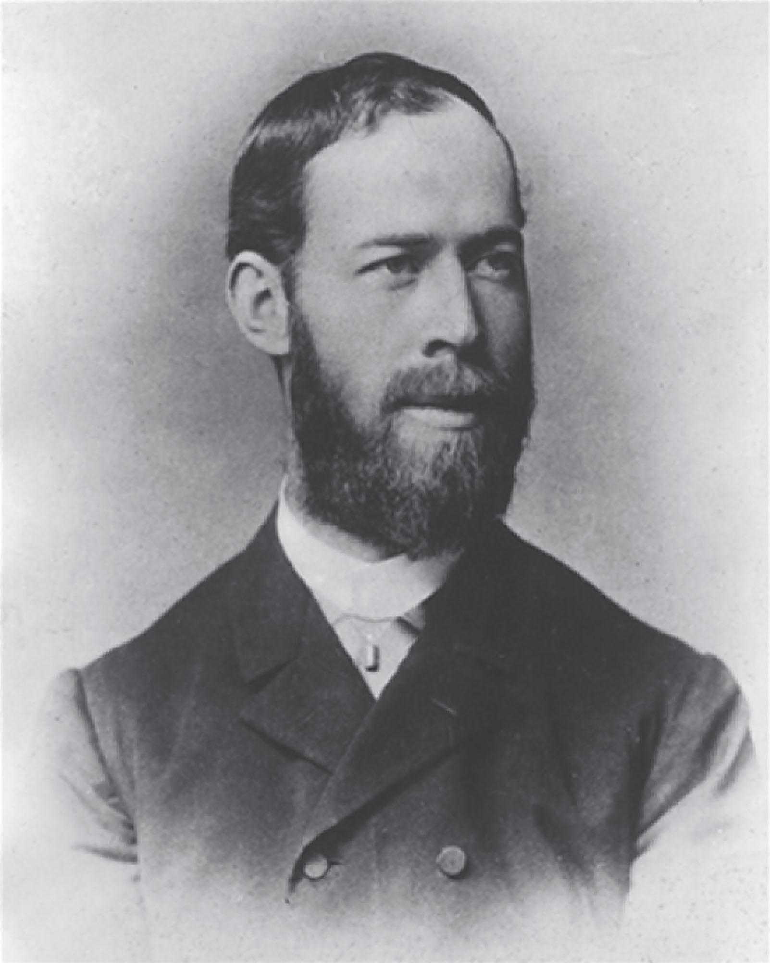
Heinrich Rudolf Hertz
1857 – 1894
German physicist
First to generate and detect electromagnetic waves in a laboratory setting
The most important discoveries were in 1887.
He also showed other wave aspects of light.
Section 34.2

Slide 14
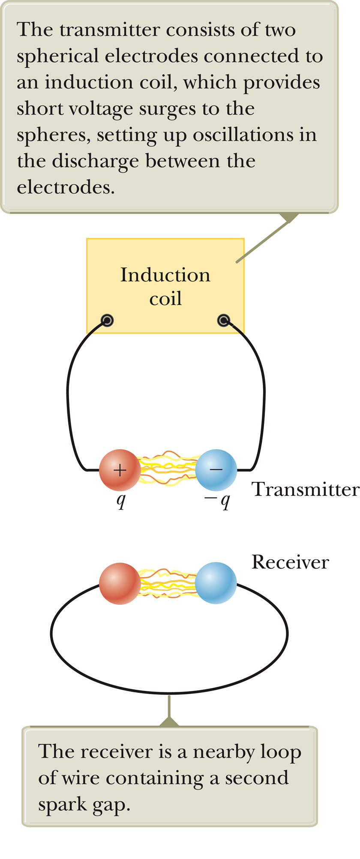
Hertz’s Experiment
An induction coil is connected to a transmitter.
The transmitter consists of two spherical electrodes separated by a narrow gap.
The coil provides short voltage surges to the electrodes.
As the air in the gap is ionized, it becomes a better conductor.
The discharge between the electrodes exhibits an oscillatory behavior at a very high frequency.
From a circuit viewpoint, this is equivalent to an LC circuit.
Section 34.2

Slide 15
Hertz’s Experiment, cont.
Sparks were induced across the gap of the receiving electrodes when the frequency of the receiver was adjusted to match that of the transmitter.
In a series of other experiments, Hertz also showed that the radiation generated by this equipment exhibited wave properties.
  Interference, diffraction, reflection, refraction and polarization
He also measured the speed of the radiation.
  It was close to the known value of the speed of light.
Section 34.2

Slide 16
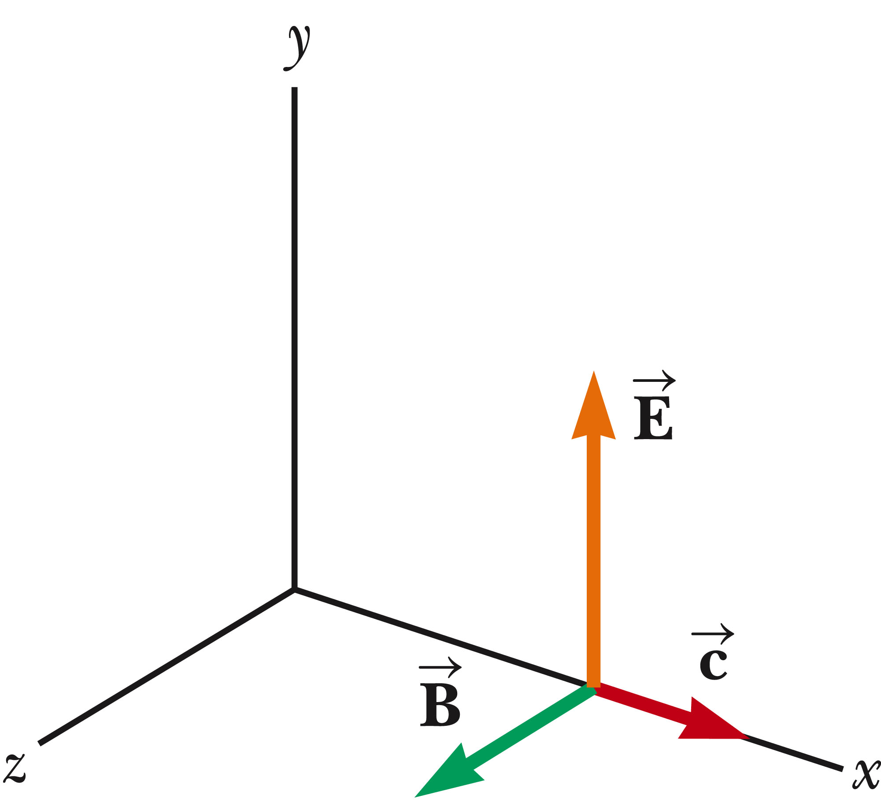
Plane Electromagnetic Waves
We will assume that the vectors for the electric and magnetic fields in an electromagnetic wave have a specific space-time behavior that is consistent with Maxwell’s equations.
Assume an electromagnetic wave that travels in the x direction with as shown.
The x-direction is the direction of propagation.
The electric field is assumed to be in the y direction and the magnetic field in the z direction.
Section 34.3

Slide 17
Plane Electromagnetic Waves, cont.
Waves in which the electric and magnetic fields are restricted to being parallel to a pair of perpendicular axes are said to be linearly polarized waves.
We also assume that at any point in space, the magnitudes E and B of the fields depend upon x and t only.
Section 34.3

Slide 18
Rays
A ray is a line along which the wave travels.
All the rays for the type of linearly polarized waves that have been discussed are parallel.
The collection of waves is called a plane wave.
A surface connecting points of equal phase on all waves, called the wave front, is a geometric plane.
A surface connecting points of radiation sends waves out radially in all directions.
  A surface connecting points of equal phase for this situation is a sphere.
  This wave is called a spherical wave.
Section 34.3

Slide 19
Waves – A Terminology Note
The word wave represents both
  The emission from a single point
  The collection of waves from all points on the source
The meaning should be clear from the context.
Section 34.3

Slide 20
Properties of em Waves
The solutions of Maxwell’s third and fourth equations are wave-like, with both E and B satisfying a wave equation.
Electromagnetic waves travel at the speed of light:
  This comes from the solution of Maxwell’s equations.
Section 34.3

Slide 21
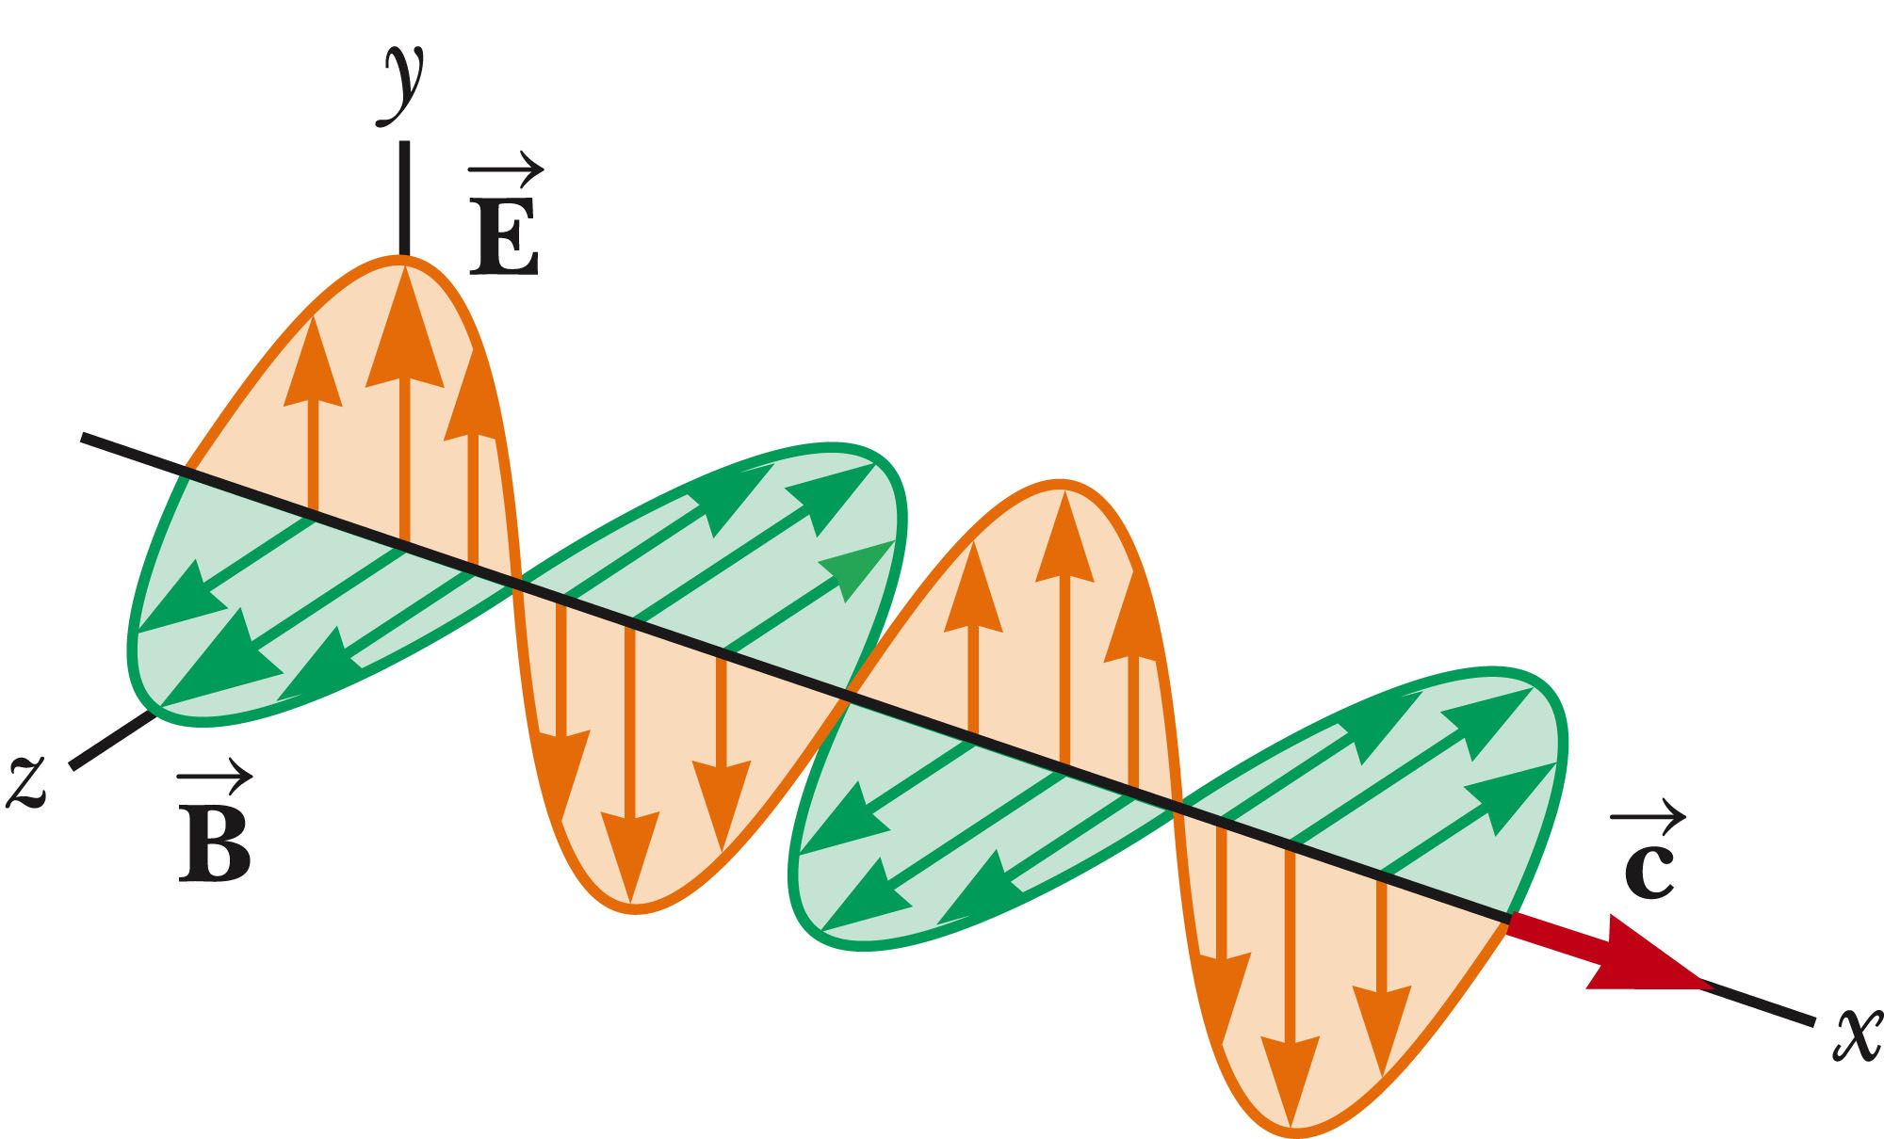
Properties of em Waves, 2
The components of the electric and magnetic fields of plane electromagnetic waves are perpendicular to each other and perpendicular to the direction of propagation.
  This can be summarized by saying that electromagnetic waves are transverse waves.
The figure represents a sinusoidal em wave moving in the x direction with a speed c.
Section 34.3

Slide 22
Properties of em Waves, 3
The magnitudes of the electric and magnetic fields in empty space are related by the expression:
  This comes from the solution of the partial differentials obtained from Maxwell’s equations.
Electromagnetic waves obey the superposition principle.
Section 34.3

Slide 23
Derivation of Speed – Some Details
From Maxwell’s equations applied to empty space, the following partial derivatives can be found:
These are in the form of a general wave equation, with
Substituting the values for μ_{o} and ε_{o} gives c = 2.99792 x 10⁸ m/s
Section 34.3

Slide 24
E to B Ratio – Some Details
The simplest solution to the partial differential equations is a sinusoidal wave:
  E = E_{max} cos (kx – ωt)
  B = B_{max} cos (kx – ωt)
The angular wave number is k = 2π/λ
  λ is the wavelength
The angular frequency is ω = 2πƒ
  ƒ is the wave frequency
Section 34.3

Slide 25
E to B Ratio – Details, cont.
The speed of the electromagnetic wave is
Taking partial derivations also gives
Section 34.3

Slide 26
Poynting Vector
Electromagnetic waves carry energy.
As they propagate through space, they can transfer that energy to objects in their path.
The rate of transfer of energy by an em wave is described by a vector, , called the Poynting vector.
Section 34.4

Slide 27
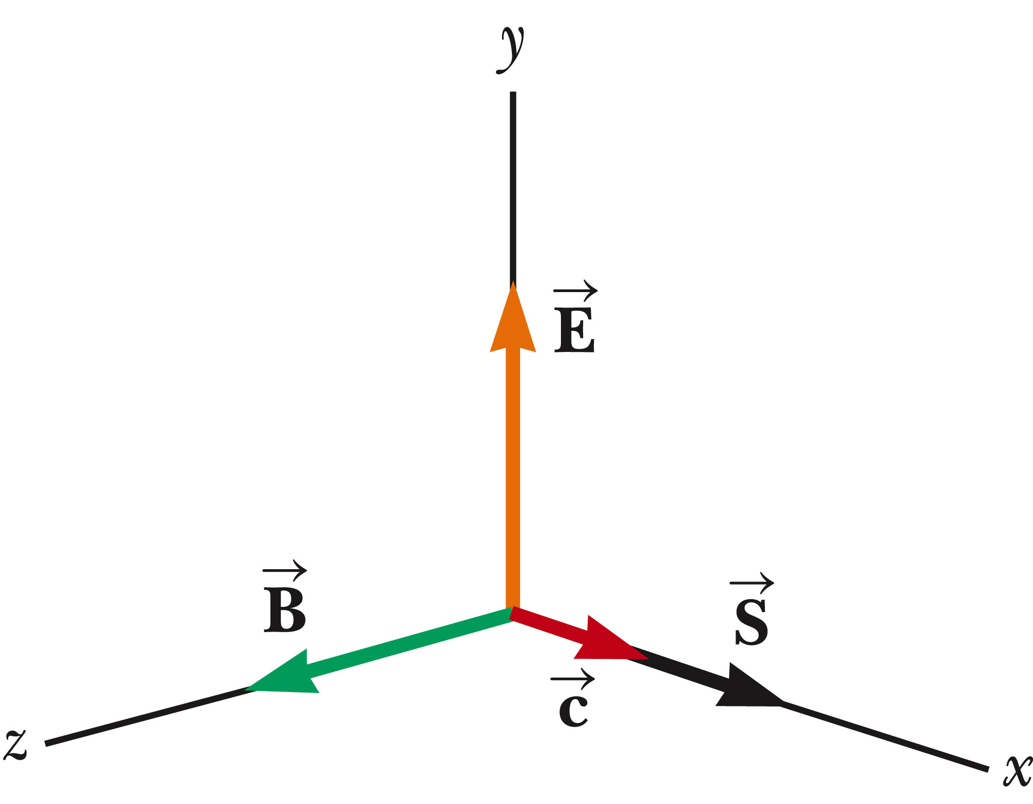
Poynting Vector, cont.
The Poynting vector is defined as
Its direction is the direction of propagation.
This is time dependent.
  Its magnitude varies in time.
  Its magnitude reaches a maximum at the same instant as .
Section 34.4

Slide 28
Poynting Vector, final
The magnitude of the vector represents the rate at which energy passes through a unit surface area perpendicular to the direction of the wave propagation.
  Therefore, the magnitude represents the power per unit area.
The SI units of the Poynting vector are J/(s.m²) = W/m².
Section 34.4

Slide 29
Intensity
The wave intensity, I, is the time average of S (the Poynting vector) over one or more cycles.
  This defines intensity in the same way as earlier.
  The optics industry calls power per unit area the irradiance.
    Radiant intensity is defined as the power in watts per solid angle.
When the average is taken, the time average of cos²(kx - ωt) = ½ is involved.
Section 34.4

Slide 30
Energy Density
The energy density, u, is the energy per unit volume.
For the electric field, u_{E}= ½ ε_{o}E²
For the magnetic field, u_{B} = ½ μ_{o}B²
Since B = E/c and
The instantaneous energy density associated with the magnetic field of an em wave equals the instantaneous energy density associated with the electric field.
  In a given volume, the energy is shared equally by the two fields.
Section 34.4

Slide 31
Energy Density, cont.
The total instantaneous energy density is the sum of the energy densities associated with each field.
  u =u_{E} + u_{B} = ε_{o}E² = B² / μ_{o}
When this is averaged over one or more cycles, the total average becomes
  u_{avg} = ε_{o}(E²)_{avg} = ½ ε_{o}E²_{max} = B²_{max} / 2μ_{o}
In terms of I, I = S_{avg} = cu_{avg}
  The intensity of an em wave equals the average energy density multiplied by the speed of light.
Section 34.4

Slide 32
Momentum
Electromagnetic waves transport momentum as well as energy.
As this momentum is absorbed by some surface, pressure is exerted on the surface.
Assuming the wave transports a total energy T_{ER} to the surface in a time interval Δt, the total momentum is p = T_{ER} / c for complete absorption.
Section 34.5

Slide 33
Pressure and Momentum
Pressure, P, is defined as the force per unit area
But the magnitude of the Poynting vector is (dT_{ER}/dt)/A and so P = S / c.
  For a perfectly absorbing surface
For a perfectly reflecting surface, p = 2T_{ER} /c and P = 2S/c
For a surface with a reflectivity somewhere between a perfect reflector and a perfect absorber, the pressure delivered to the surface will be somewhere in between S/c and 2S/c.
For direct sunlight, the radiation pressure is about 5 x 10⁻⁶ N/m² .
Section 34.5

Slide 34
Production of em Waves by an Antenna
Neither stationary charges nor steady currents can produce electromagnetic waves.
The fundamental mechanism responsible for this radiation is the acceleration of a charged particle.
Whenever a charged particle accelerates, it radiates energy.
Section 34.6

Slide 35
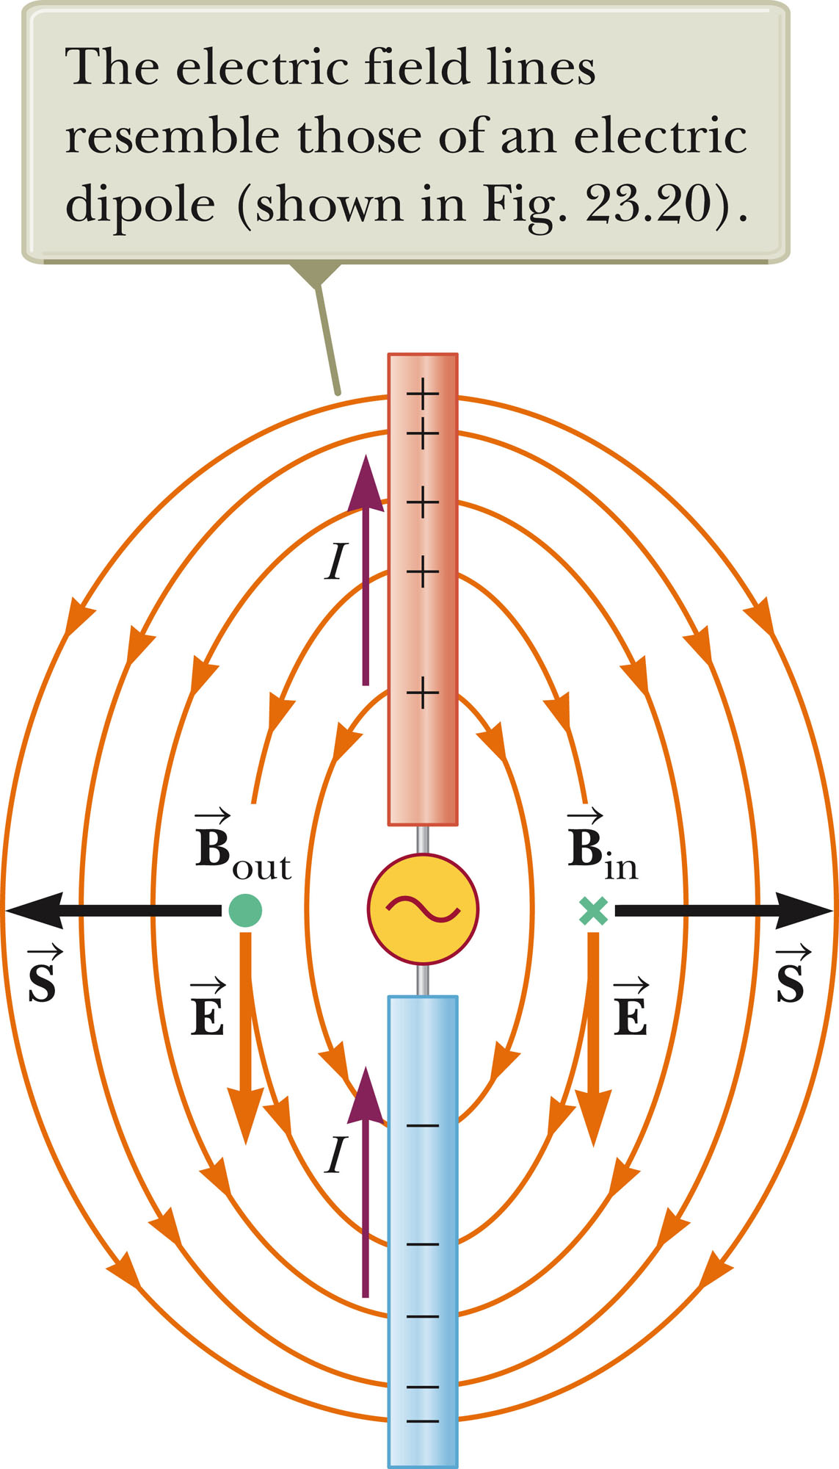
Production of em Waves by an Antenna, 2
This is a half-wave antenna.
Two conducting rods are connected to a source of alternating voltage.
The length of each rod is one-quarter of the wavelength of the radiation to be emitted.
Section 34.6

Slide 36
Production of em Waves by an Antenna, final
The oscillator forces the charges to accelerate between the two rods.
The antenna can be approximated by an oscillating electric dipole.
The magnetic field lines form concentric circles around the antenna and are perpendicular to the electric field lines at all points.
The electric and magnetic fields are 90º out of phase at all times.
This dipole energy dies out quickly as you move away from the antenna.
The source of the radiation found far from the antenna is the continuous induction of an electric field by the time-varying magnetic field and the induction of a magnetic field by a time-varying electric field.
The electric and magnetic field produced in this manner are in phase with each other and vary as 1/r.
The result is the outward flow of energy at all times.
Section 34.6

Slide 37
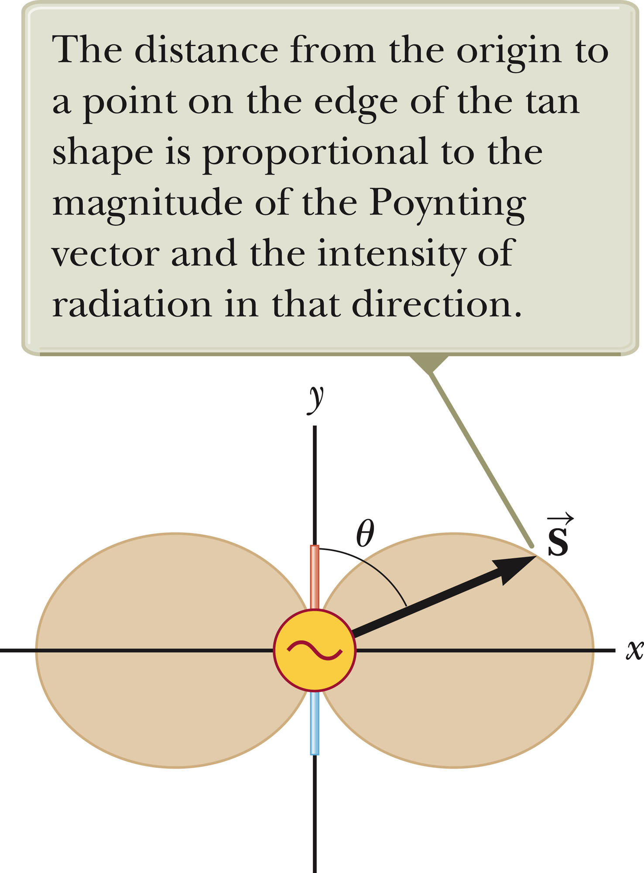
Angular Dependence of Intensity
This shows the angular dependence of the radiation intensity produced by a dipole antenna.
The intensity and power radiated are a maximum in a plane that is perpendicular to the antenna and passing through its midpoint.
The intensity varies as (sin² θ) / r²
Section 34.6

Slide 38
The Spectrum of EM Waves
Various types of electromagnetic waves make up the em spectrum.
There is no sharp division between one kind of em wave and the next.
All forms of the various types of radiation are produced by the same phenomenon – accelerating charges.
Section 34.7

Slide 39
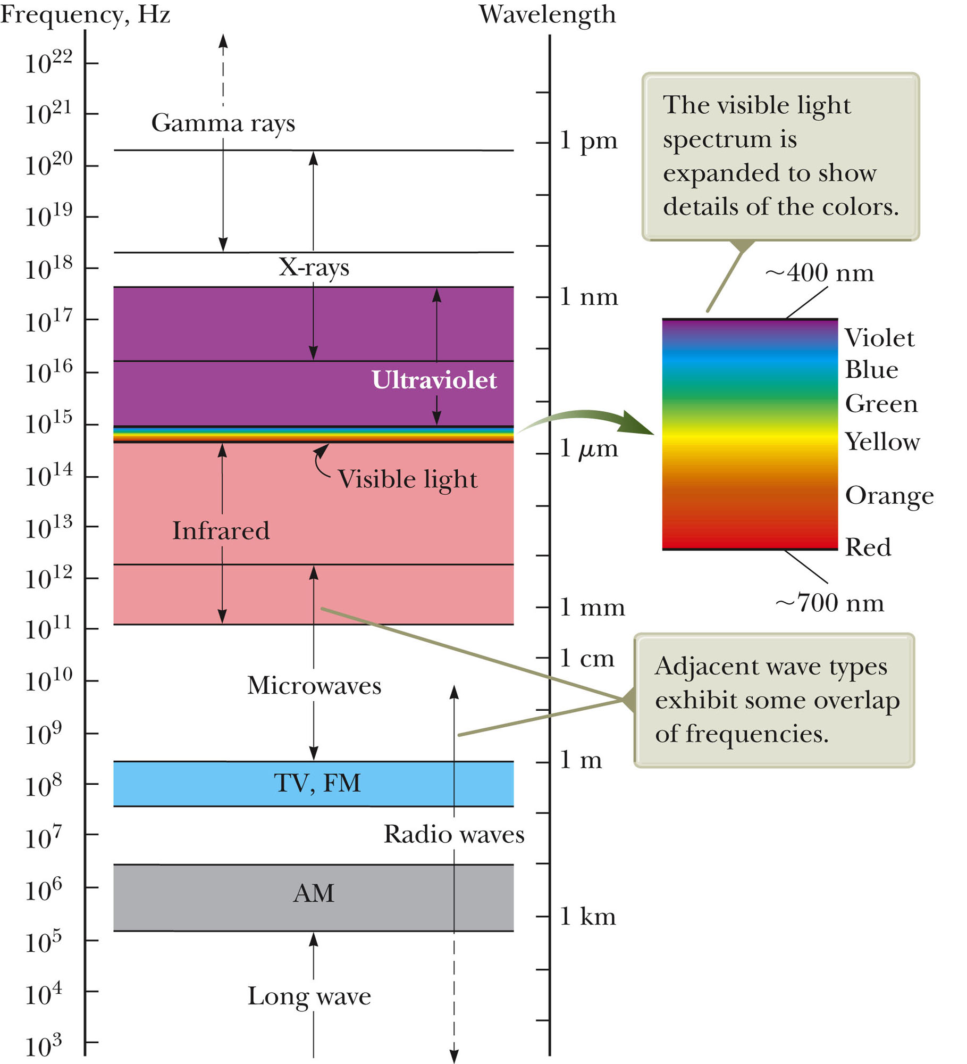
The EM Spectrum
Note the overlap between types of waves
Visible light is a small portion of the spectrum.
Types are distinguished by frequency or wavelength
Section 34.7

Slide 40
Notes on the EM Spectrum
Radio Waves
  Wavelengths of more than 10⁴ m to about 0.1 m
  Used in radio and television communication systems
Microwaves
  Wavelengths from about 0.3 m to 10⁻⁴ m
  Well suited for radar systems
  Microwave ovens are an application
Section 34.7

Slide 41
Notes on the EM Spectrum, 2
Infrared waves
  Wavelengths of about 10⁻³ m to 7 x 10⁻⁷ m
  Incorrectly called “heat waves”
  Produced by hot objects and molecules
  Readily absorbed by most materials
Visible light
  Part of the spectrum detected by the human eye
  Most sensitive at about 5.5 x 10⁻⁷ m (yellow-green)
Section 34.7

Slide 42
More About Visible Light
Different wavelengths correspond to different colors.
The range is from red (λ ~ 7 x 10⁻⁷ m) to violet (λ ~4 x 10⁻⁷ m).
Section 34.7

Slide 43
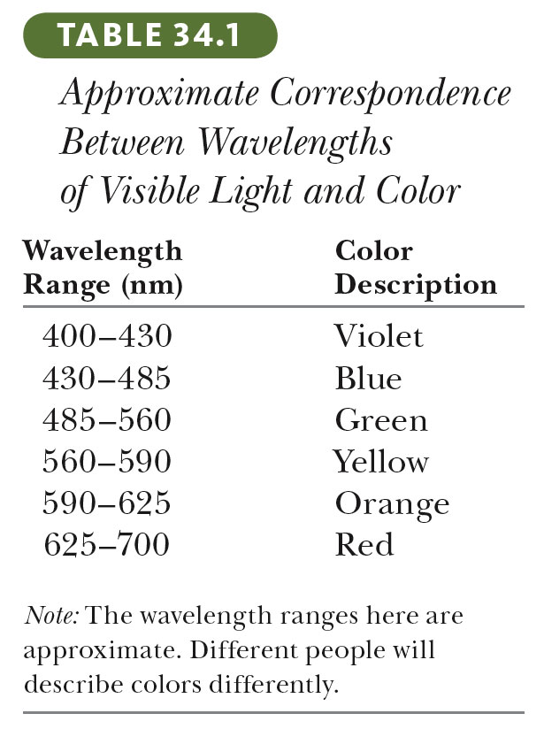
Visible Light, cont
Section 34.7

Slide 44
Notes on the EM Spectrum, 3
Ultraviolet light
  Covers about 4 x 10⁻⁷ m to 6 x 10⁻¹⁰ m
  Sun is an important source of uv light
  Most uv light from the sun is absorbed in the stratosphere by ozone
X-rays
  Wavelengths of about 10⁻⁸ m to 10⁻¹² m
  Most common source is acceleration of high-energy electrons striking a metal target
  Used as a diagnostic tool in medicine
Section 34.7

Slide 45
Notes on the EM Spectrum, final
Gamma rays
  Wavelengths of about 10⁻¹⁰ m to 10⁻¹⁴ m
  Emitted by radioactive nuclei
  Highly penetrating and cause serious damage when absorbed by living tissue
Looking at objects in different portions of the spectrum can produce different information.
Section 34.7

Slide 46
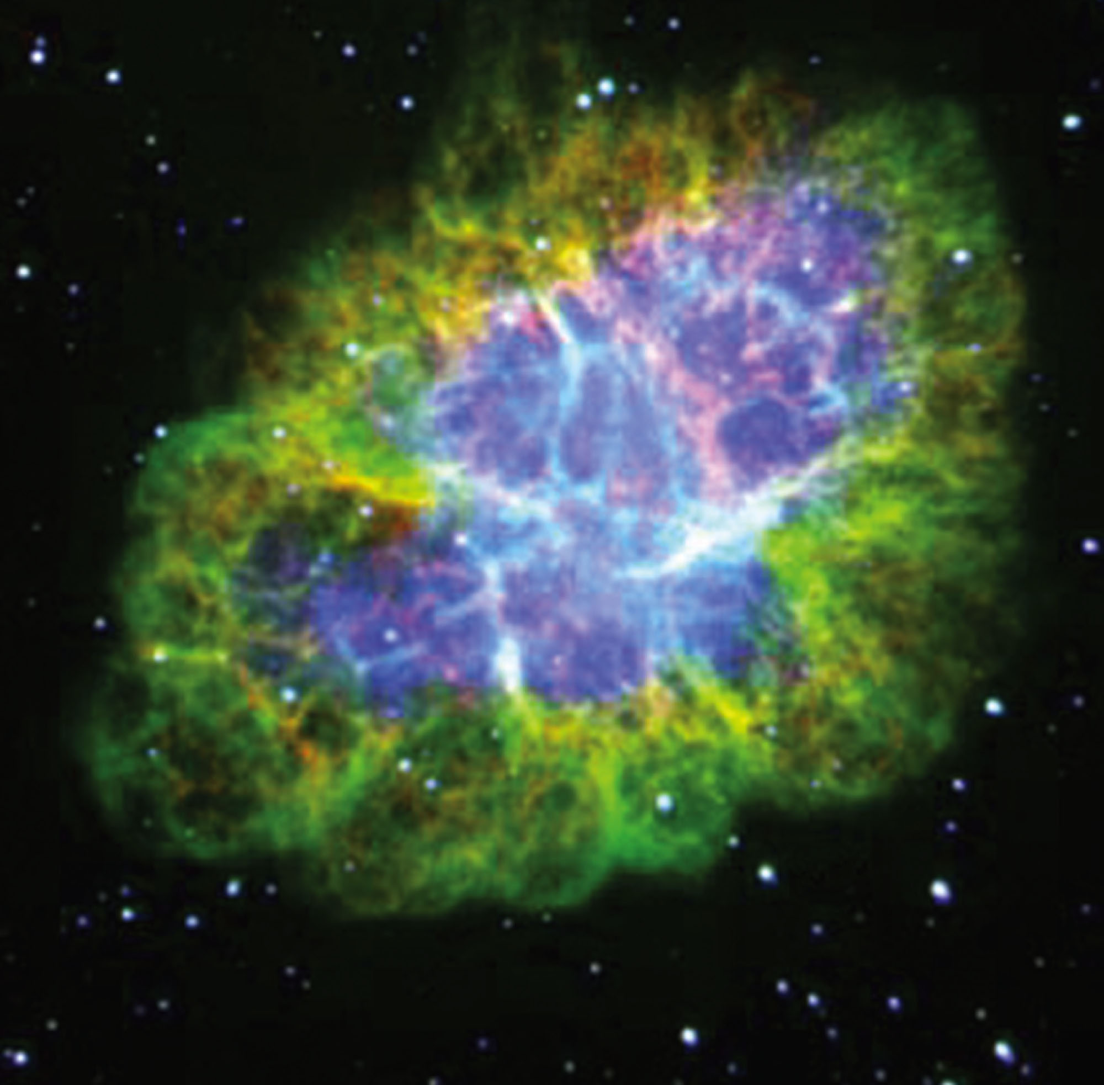
Wavelengths and Information
These are images of the Crab Nebula.
They are (clockwise from upper left) taken with:
  x-rays
  visible light
  radio waves
  infrared waves
Section 34.7

